Slide 1
YOUR CAREER AT ALC
New Hire Orientation

Slide 2
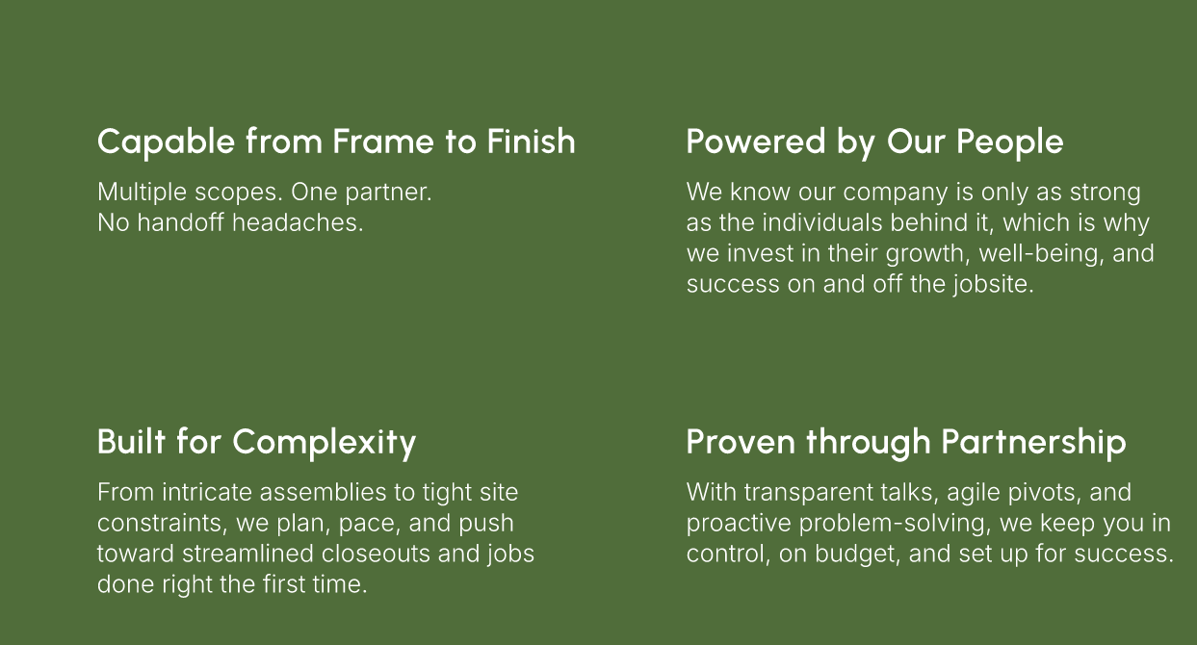
Who we are

Slide 3

Our Vision

Slide 4
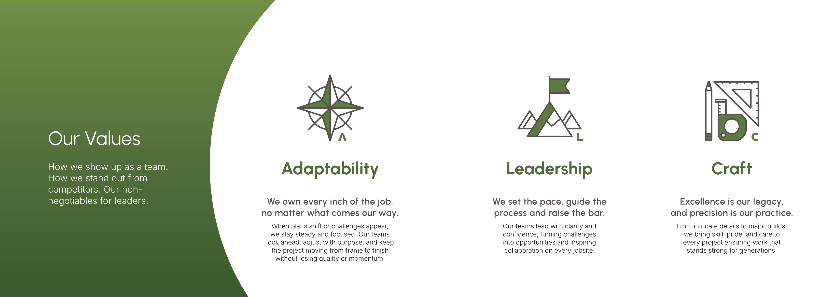
Core Values

Slide 5

Our Mission

Slide 6
Safety

Slide 7
Important Safety Topics
Wear your PPE! (non-negotiable)
Never bypass a safety measure – no shortcuts
See something, say something!
Safety is EVERYONE’S responsibility
Safety Committee can be reached at safety@buildwithalc.com
The goal is to go home in the same or better condition
Report all incidents, near misses, and injuries within your shift

Slide 8
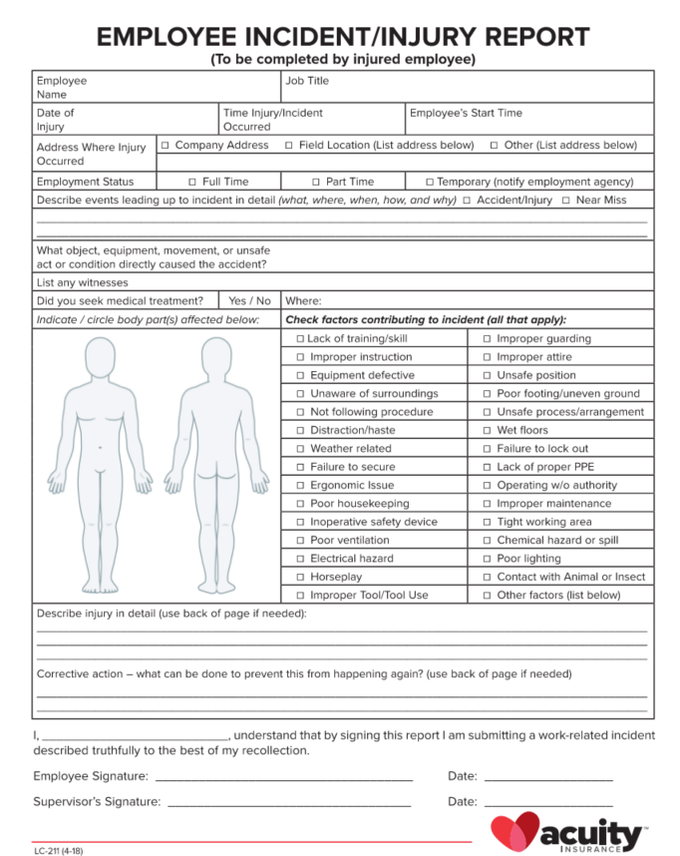
Incident Reporting
Report to Foreman immediately
Complete Incident Report
Follow-up with HR and keep everyone updated; communication is key!

Slide 9
Safety Videos
New Hire Orientation
Scaffolding
Lifts
Fall Protection
Anti-Harassment

Slide 10
Key Policies

Slide 11
Travel Pay
NORMAL COMMUTE
Mileage reimbursement of $0.725/mile for miles travelled over 40. Miles compensated begin at mile 41; each way, and for each day travelled.
Not taxed
OVERNIGHTS (must be a minimum of 90 minutes from your home).
Lodging is covered at $130 per night
Food is covered at $25 per day
Mileage is included for going there and back only
Not taxed
$5/hr for hours worked
Taxed

Slide 12
Progressive Discipline
DOCUMENTED VERBAL WARNING
First step; intended to notify employee that an improvement is needed in behavior or performance
WRITTEN WARNING
Second step; intended to notify employee that continued behavior/performance need to be resolved
FINAL WARNING
Last chance; intended to notify employee that continued behavior/performance will result in termination if not resolved
IMMEDIATE TERMINATION
Behavior that is not subject to progressive discipline such as violation of highly hazardous safety practice, stealing, destruction of property, excessive absenteeism, insubordination, any behavior that negatively impacts the company, other employees, or customers.
Actions requiring discipline and the progression of disciplinary steps that will be followed may vary at the sole discretion of ALC and will not necessarily be limited to the actions listed in this policy. Not all actions which might warrant discipline are specifically included in this policy.

Slide 13
ALC Star Recognition
To recognize for contributions towards ALC success in the areas of Adaptability, Leadership & Craft. The intent of this program is to reward for actions and behaviors that are “above and beyond” the expectations of the job.
Nominated by peer or Foreman
$50 and handwritten thank you
ALC Star of the Year will be selected and awarded a significant prize at All Employee Meeting

Slide 14
Parental Leave
A maximum of 2 weeks paid parental leave for birth, adoption, or placement of a child/children. Employees must meet one of the following criteria to be eligible for parental leave:
Be a biological parent
Be a spouse or same-sex spousal equivalent to a birth parent
Adopted or been placed with foster child (child must be age 16 or younger)
Adoption of a new spouse’s child is excluded
Have a child through surrogacy
Requirements:
Leave must be taken at time of birth, adoption, or placement.
Must take parental leave in one continuous period of time.
Any unused leave will be forfeited
All parental leave requests must be done through HR & substantiated.
Parental leave requests need to be communicated to HR in advance of birth or adoption.
ALC reserves the right to deny parental leave requests due to lack of communication and/or ability to substantiate through medical or court certified documentation.

Slide 15

Company Events
Leadman Meeting (May)
Summer Family Picnic – Timber Rattlers Stadium (July/August)
All Employee Meeting (December)
End of Year Celebration (January)

Slide 16
Payroll Items
Paid on THURSDAYS for the hours worked the week prior
Paystubs are emailed and can be downloaded
Paystub password is last four of your social and first four of your last name in CAPS
xxxxSCHM

